Slide 1
NB-IOT自動化定位監測系統應用於貨件追縱之構想
電信所 林柏呈

Slide 2
Outline
Motivation
Concept of Design
Business Model
System Model
Lora
MQTT
Implementation
Http User Interface
Future Work

Slide 3
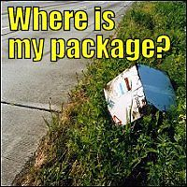
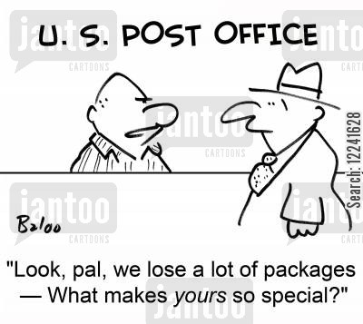
Motivation
Ref: https://www.jantoo.com/cartoons/keywords/losing-packages

Slide 4
Concept of Design
位置資料利用Lora傳至鄰近Gateway
將GPS放入貨件
GPS定位貨件位置
資料藉由MQTT傳至網頁伺服器
將資料存置資料庫與網頁前端
隨時瀏覽網頁追蹤貨件位置
GPS寄還寄件者
貨件送達

Slide 5
Business Model
資訊業者與宅配合作
以每月一期的租約方式出租GPS定位追蹤器。依每期使用次數的不同調整租約費用，業者可依市場需求選擇方案。
使用租約模式之益處：
非隨時需要寄送貴重物品
降低成本
租約可提供宅配固定人工成本

Slide 6


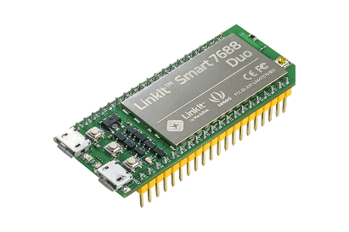
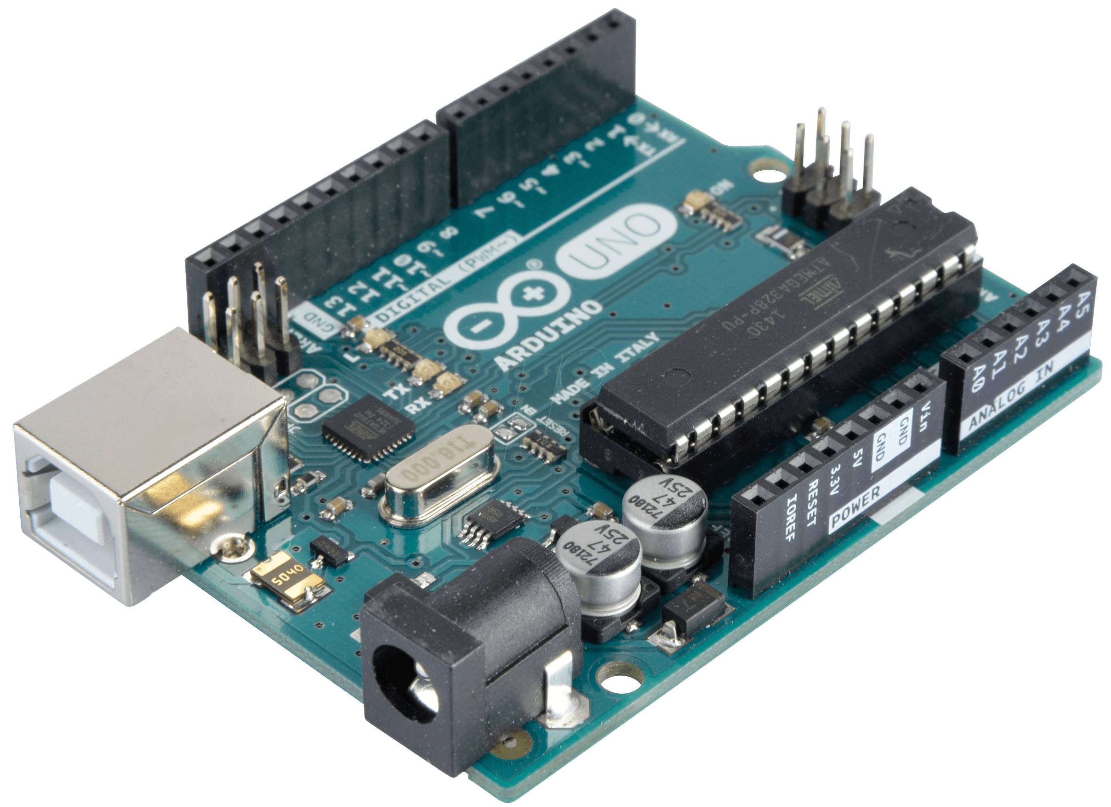
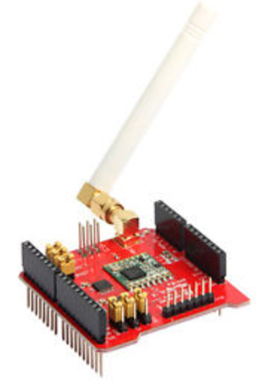

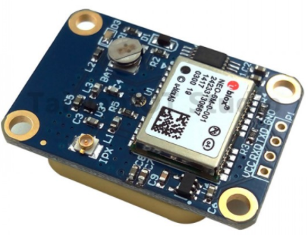
System Model
Lora Mote
Lora Gateway
Database
Web Server
Linkit 7688 duo
Dragino Lora Sheild
MQTT
Arduino Uno
LORA
(3)
(2)
(1)
(4)
(5)
Dragino Lora Sheild
Ublox NEO-6M V2 GPS
Http Interface
Google Map application

Slide 7

Lora
low data rate
(range from 0.3 kbps to 50 kbps)
低功耗
長距離 line-of-sight 可以傳到20km遠
長電池壽命
(Bi-directional communication with
Class-A)
Ref: https://read01.com/5xzLQE.html

Slide 8

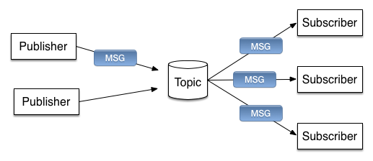
MQTT
Allow devices to publish-and-subscribe to
messages being broadcast over an
TCP/IP network.
Messages are simply composed of
a topic and a payload
MQTT can handle everything from Ethernet
to packet sized data to megabytes
Has options for managing unreliable connections
Ref: http://blog.maxkit.com.tw/2014/01/mqtt.html

Slide 9
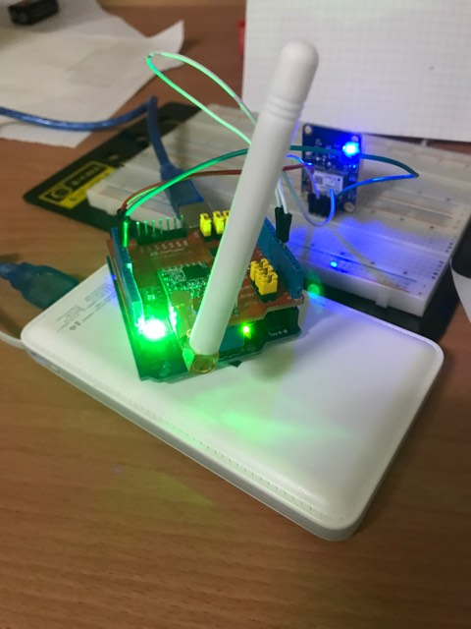
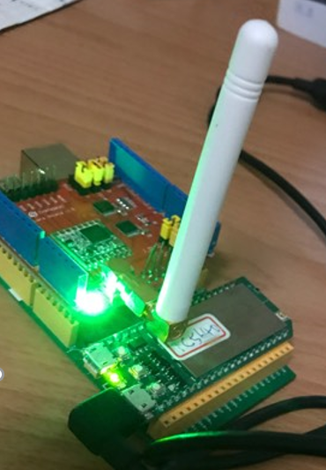
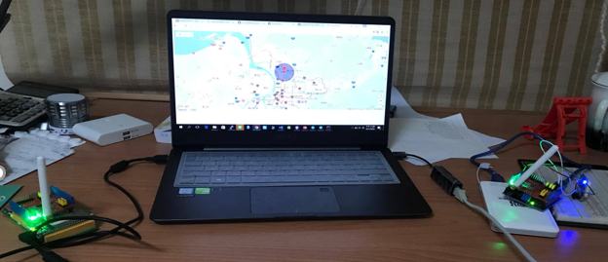
Implementation
Lora Mote
Lora Gateway
GPS System

Slide 10
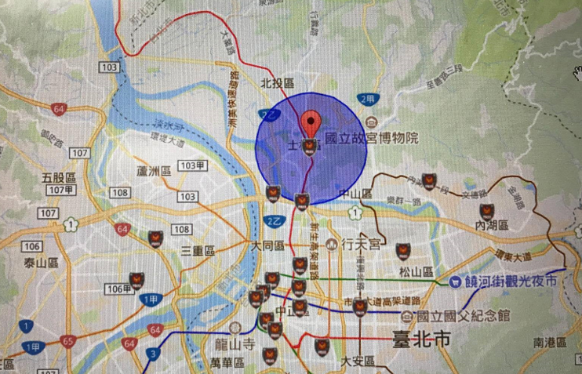
HTTP User Interface

Slide 11
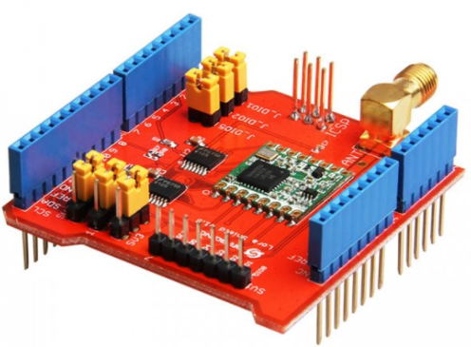
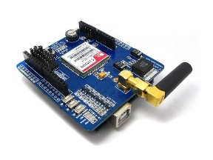

Lora Mote
Future Work
Lora Gateway
Linkit 7688 duo
Dragino Lora Shield
Arduino Uno
Web Server
Database
Dragino Lora Sheild
MQTT
LORA
(3)
(2)
(1)
Ublox NEO-6M V2 GPS
(7)
(4)
(8)
(6)
(5)
SIMCOM SIM900 GPRS/GSM Module
Http Interface
Google Map application
(9)
Police Station

Slide 12
Thanks!

